Slide 1
Bayesian
Trees

Slide 2
Bayes
Bayes' theorem to compute and update probabilities after obtaining new data
Bayes' theorem describes the conditional probability of an event based on data as well as prior information or beliefs about the event or conditions related to the event.

Slide 3


Slide 4
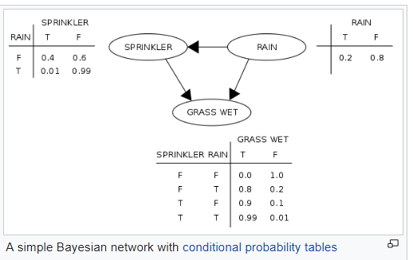

Slide 5
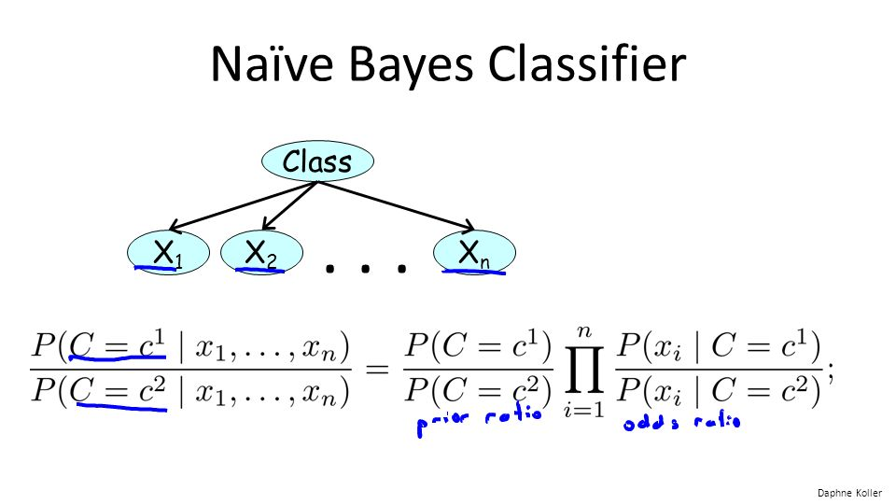

Slide 6
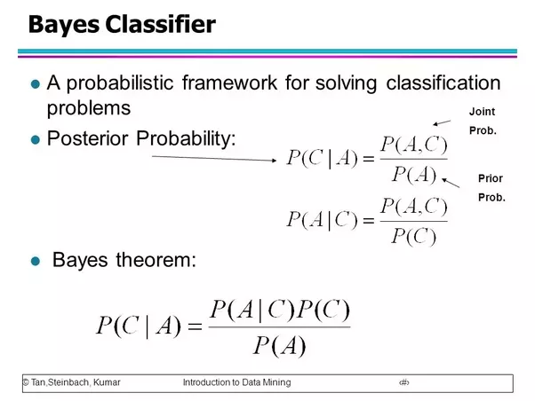

Slide 7
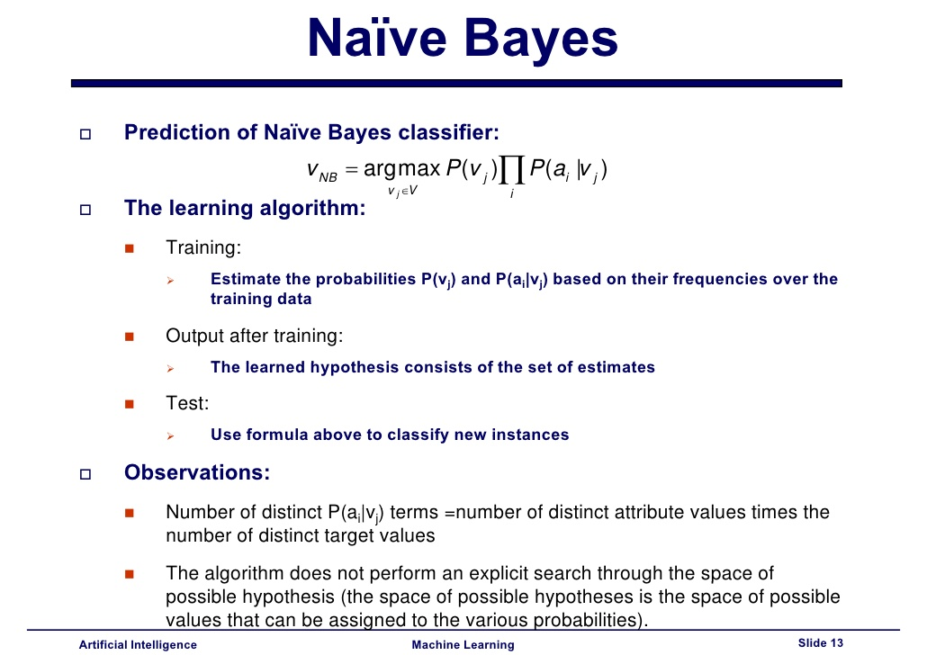

Slide 8
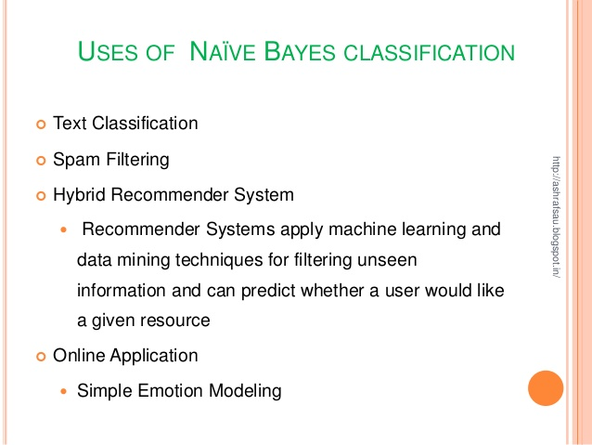

Slide 9
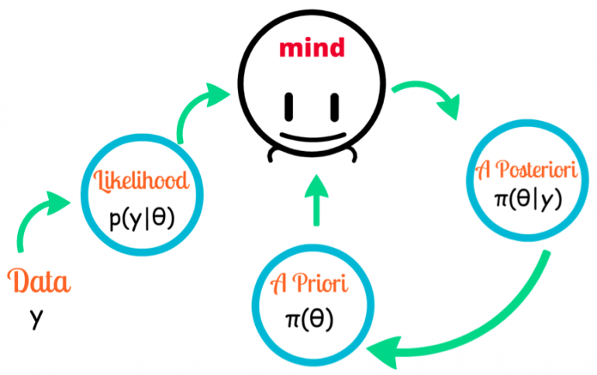

Slide 11
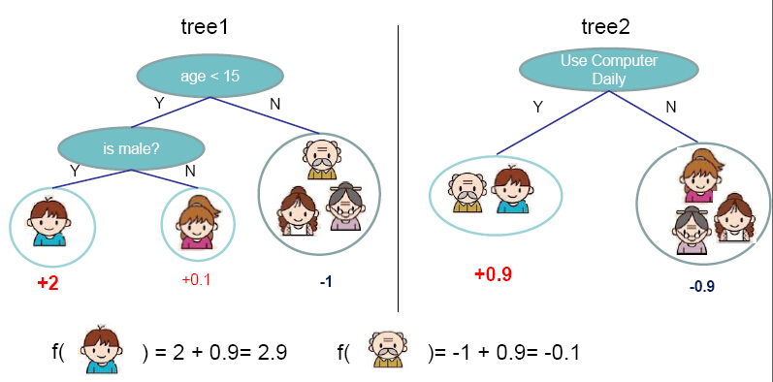
Tree

Slide 12
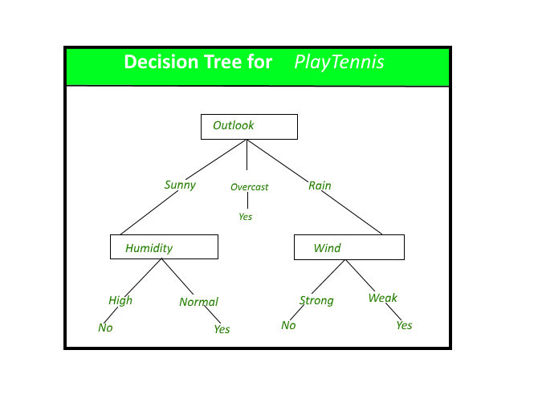

Slide 13
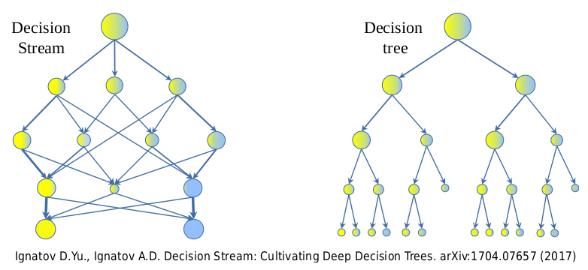

Slide 14
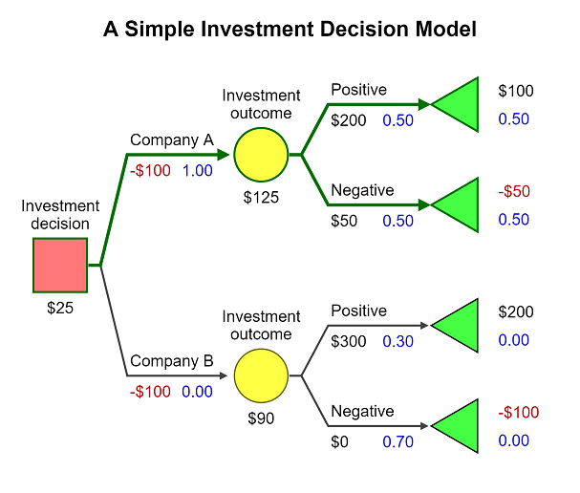

Slide 15
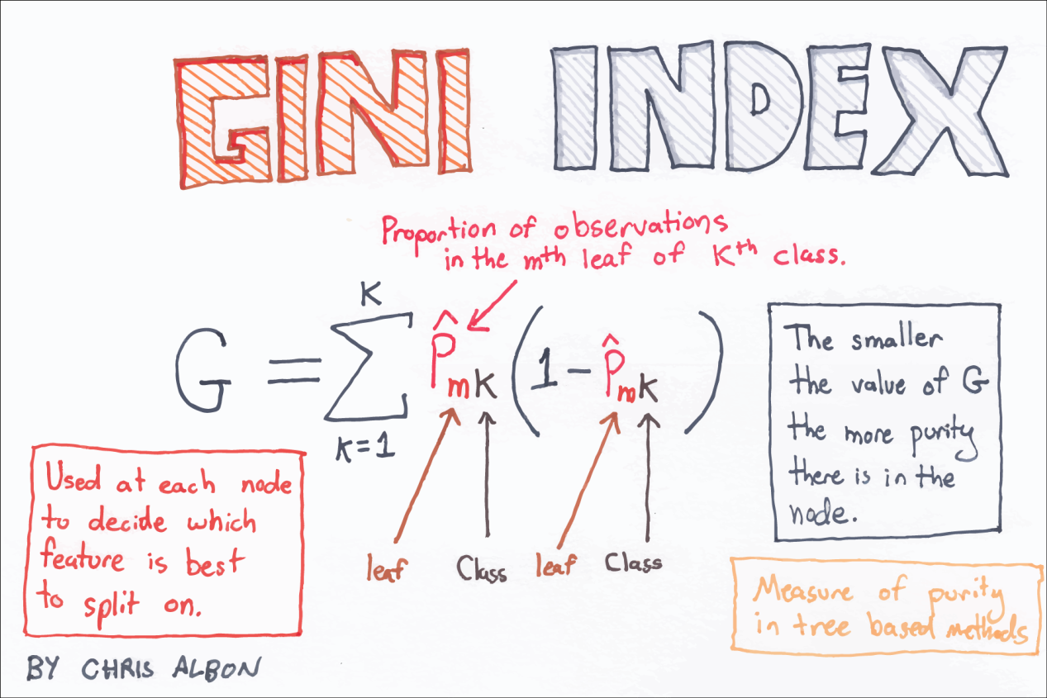

Slide 16
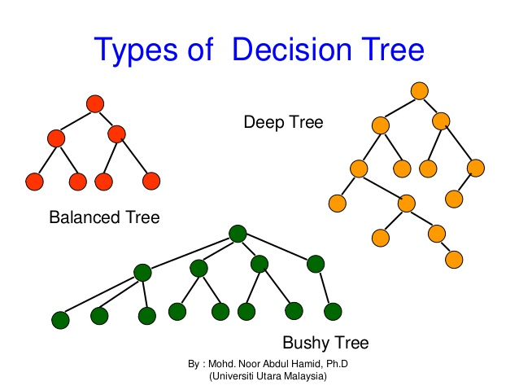

Slide 17
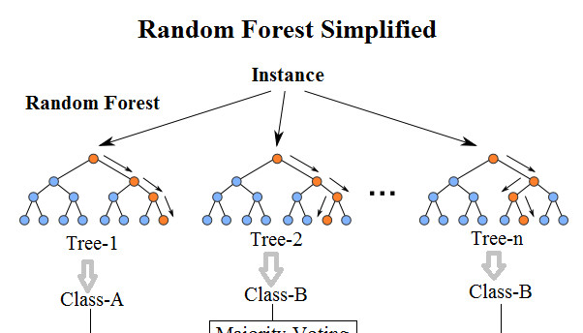
random forest

Slide 18
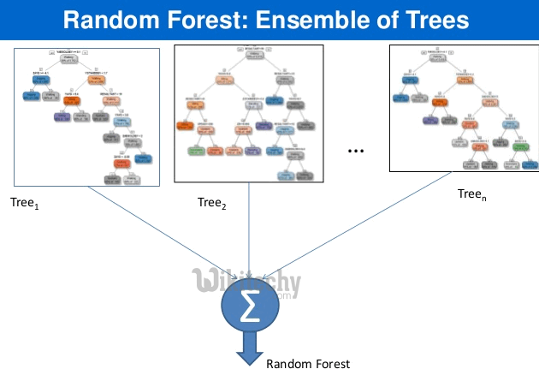

Slide 19
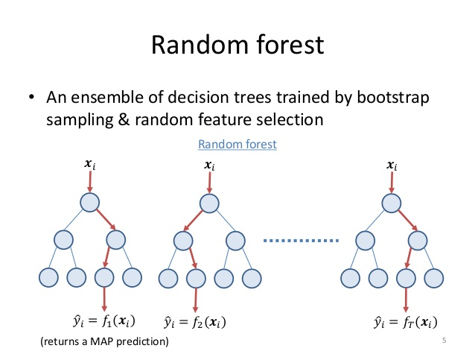

Slide 20
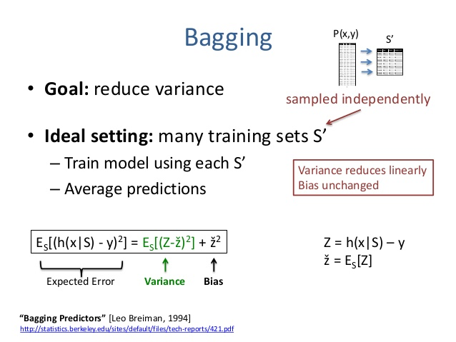
Bagging

Slide 21
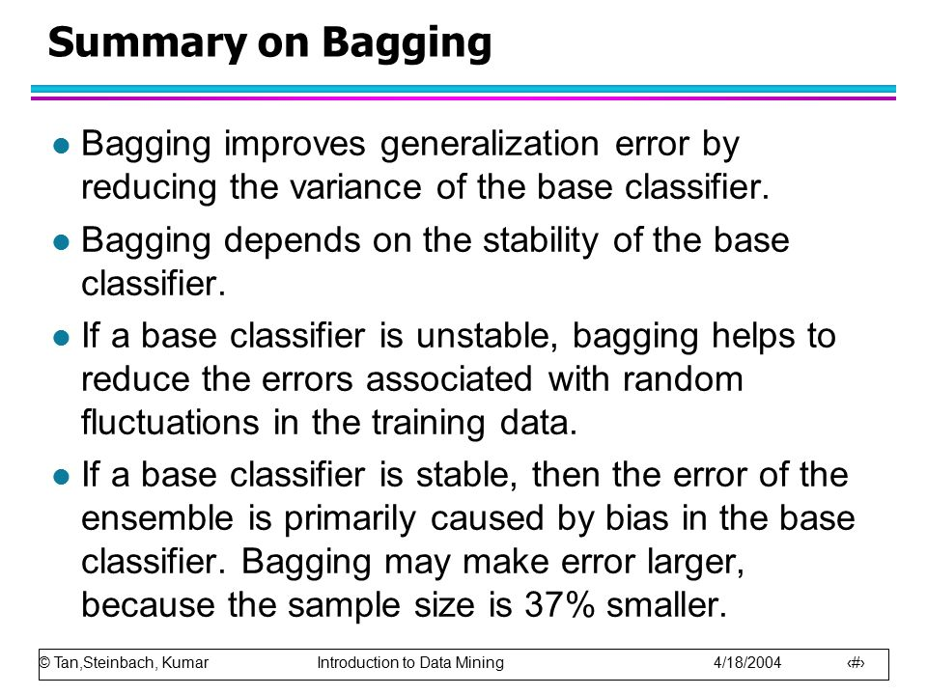

Slide 22
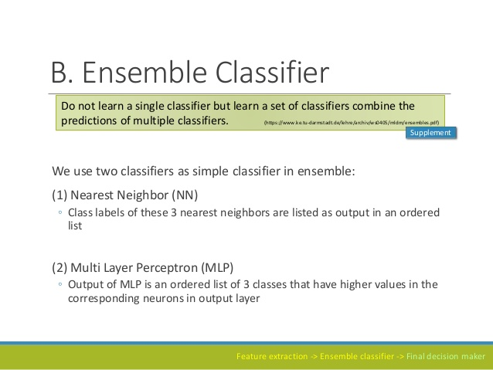

Slide 23
Out of Bag Predictions for Continuous Variable

Slide 24
Bagging (Bootstrap Aggregating)
Generates m new training data sets.
Each new training data set picks a sample of observations with replacement (bootstrap sample) from original data set.
By sampling with replacement, some observations may be repeated in each new training data set.
The m models are fitted using the above m bootstrap samples and combined by averaging the output (for regression) or voting (for classification).

Slide 25
Out-of-Bag Error (Misclassification Rate)

Slide 26
It is a random with replacement sampling method.
Example : Suppose we have a bowl of 100 unique numbers from 0 to 99. We want to select a random sample of numbers from the bowl. If we put the number back in the bowl, it may be selected more than once. In this process, we are sampling randomly with replacement.

Slide 27
Shortcomings of Random Forest:
Random Forests aren't good at generalizing cases with completely new data. For example, if I tell you that one ice-cream costs $1, 2 ice-creams cost $2, and 3 ice-creams cost $3, how much do 10 ice-creams cost? A linear regression can easily figure this out, while a Random Forest has no way of finding the answer.
Random forests are biased towards the categorical variable having multiple levels (categories). It is because feature selection based on impurity reduction is biased towards preferring variables with more categories so variable selection (importance) is not accurate for this type of data.

Slide 28
ensemble methods use multiple learning algorithms to obtain better predictive performance than could be obtained from any of the constituent learning algorithms alone.
supervised learning algorithm

Slide 29
Bayes optimal classifier
Bootstrap aggregating (bagging)
Boosting

Slide 30
Malware Detection
Intrusion detection
Face recognition

Slide 31
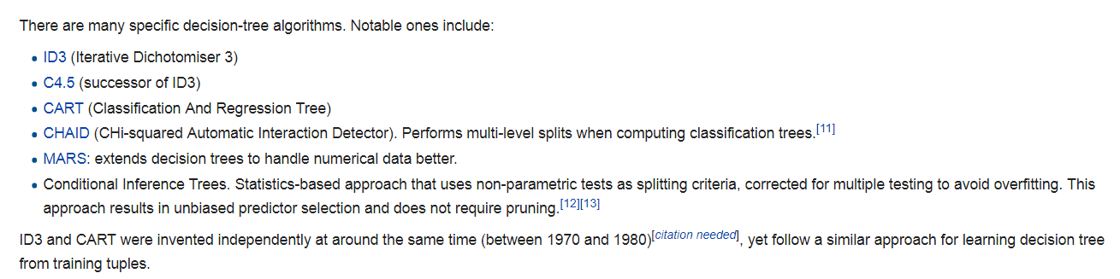
CART (classification and regression tree) algorithm

Slide 32
Gini ratio (or a normalized Gini index) is a measure of statistical dispersion intended to represent the income or wealth distribution of a nation's residents, and is the most commonly used measurement of inequality

Slide 33
The first algorithm for random decision forests was created by Tin Kam Ho^{[1]} using the random subspace method,^{[2]}which, in Ho's formulation, is a way to implement the "stochastic discrimination" approach to classification proposed by Eugene Kleinberg

Slide 34
Gradient boosting
Gradient boosting is a machine learning technique for regression and classification problems, which produces a prediction model in the form of an ensemble of weak prediction models, typically decision trees.

Slide 35
Stochastic gradient descent (often shortened to SGD), also known as incremental gradient descent, is an
iterative method for optimizing
a differentiable objective function, a stochastic approximation of gradient descent optimization.

Slide 36
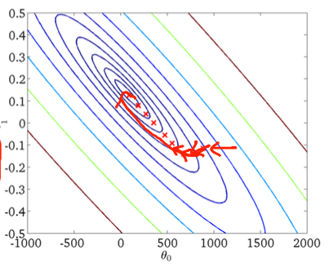

Slide 37
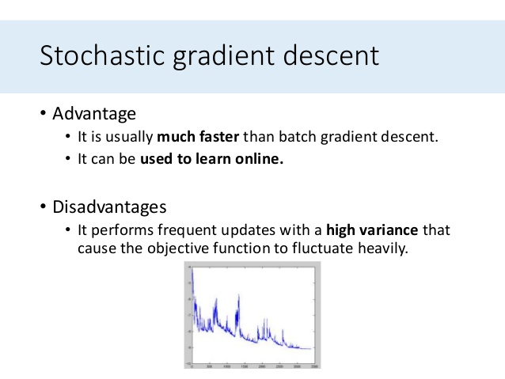

Slide 38
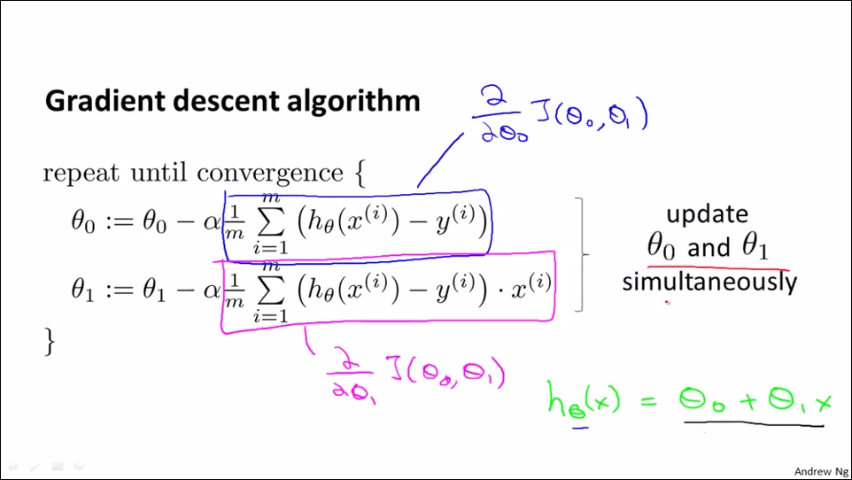

Slide 39
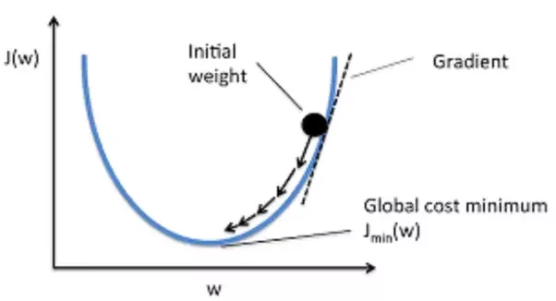

Slide 40
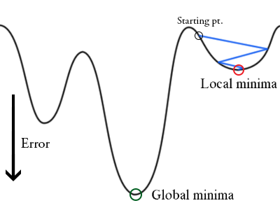

Slide 41
stochastic
having a
random probability distribution
or pattern that may be analysed statistically but
may not be predicted precisely.

Slide 42
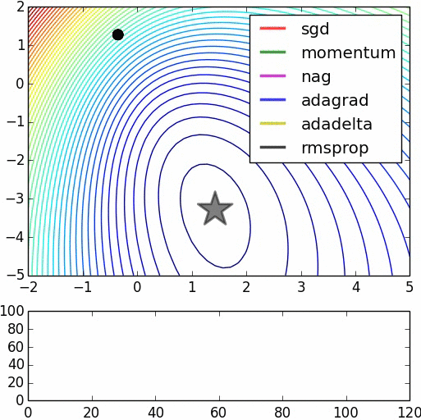
SGD

Slide 43
